Slide 1
Summary master Easter 2020
Ivar Svalheim Haugerud

Slide 2
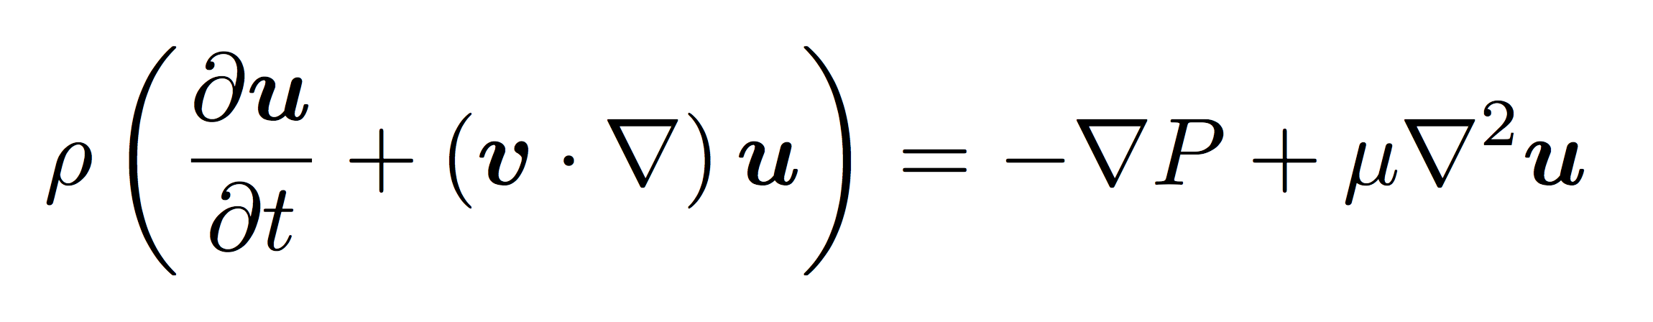
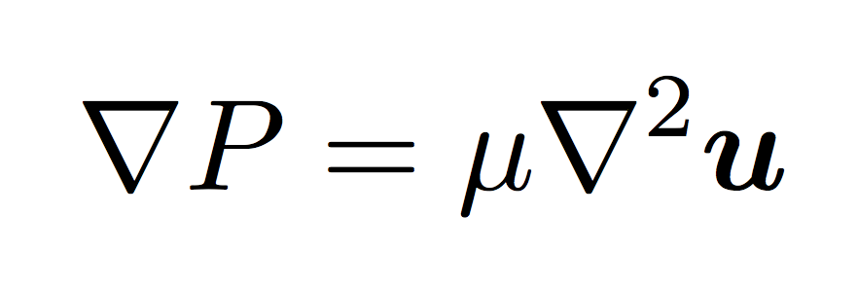
Solving Navier-Stokes

Slide 3
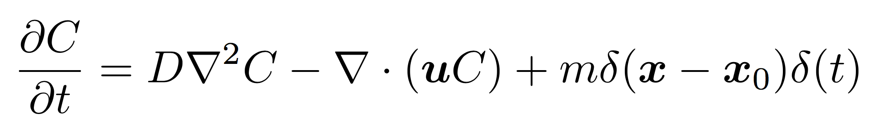
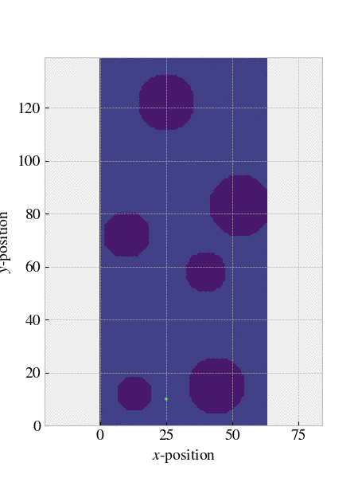

Reciprocal relation

Slide 4
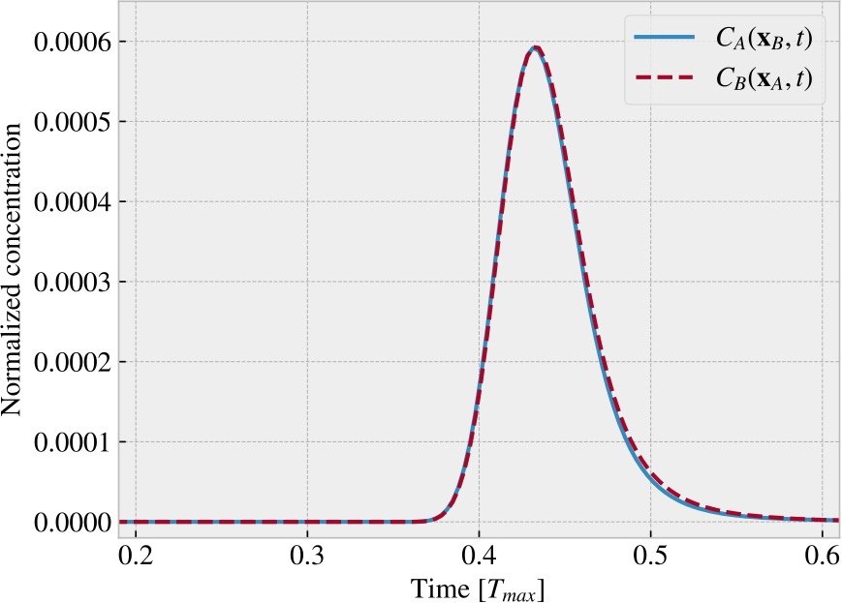
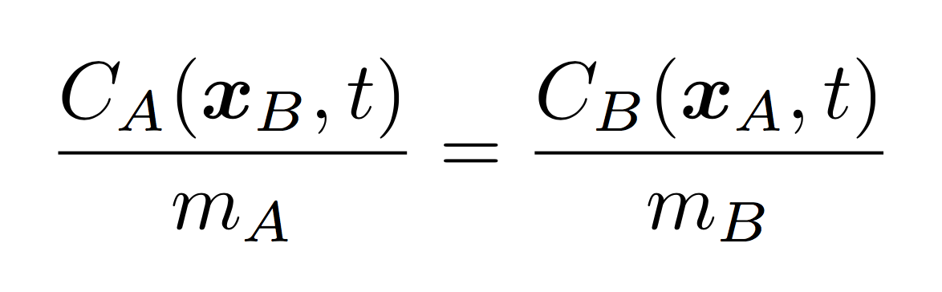
Reciprocal relation

Slide 5
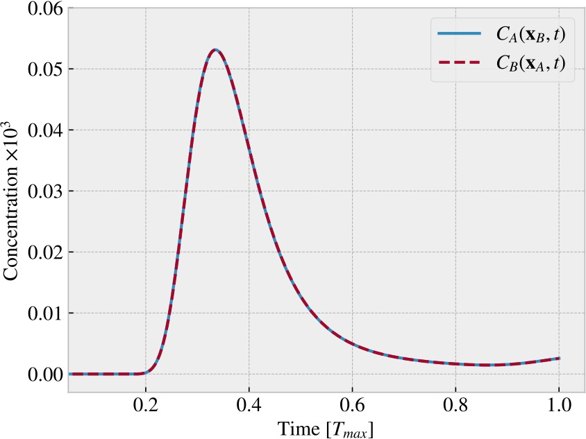
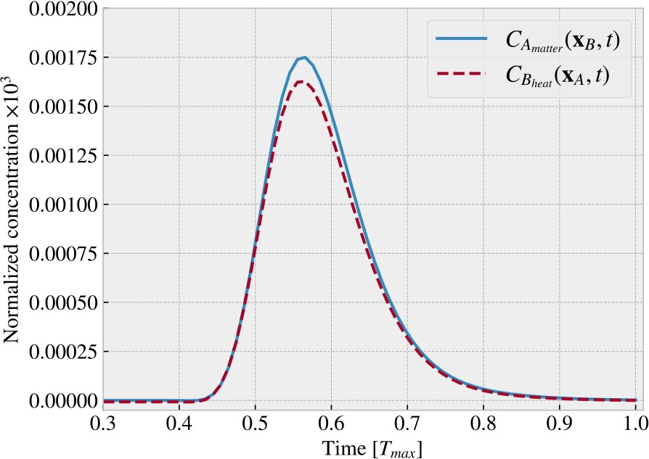
Thermal diffusion
Heat both ways: Re = 3.8*1e-4, Pe = 9.7
Heat one way, matter the other:
Re = 2.4*1e-3, Pe = 60.3.
Differenet boundary conditions, heat not conserved

Slide 6
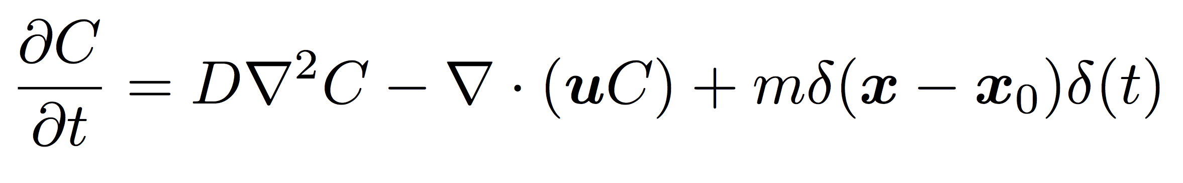
Constant Peclet number

Slide 7
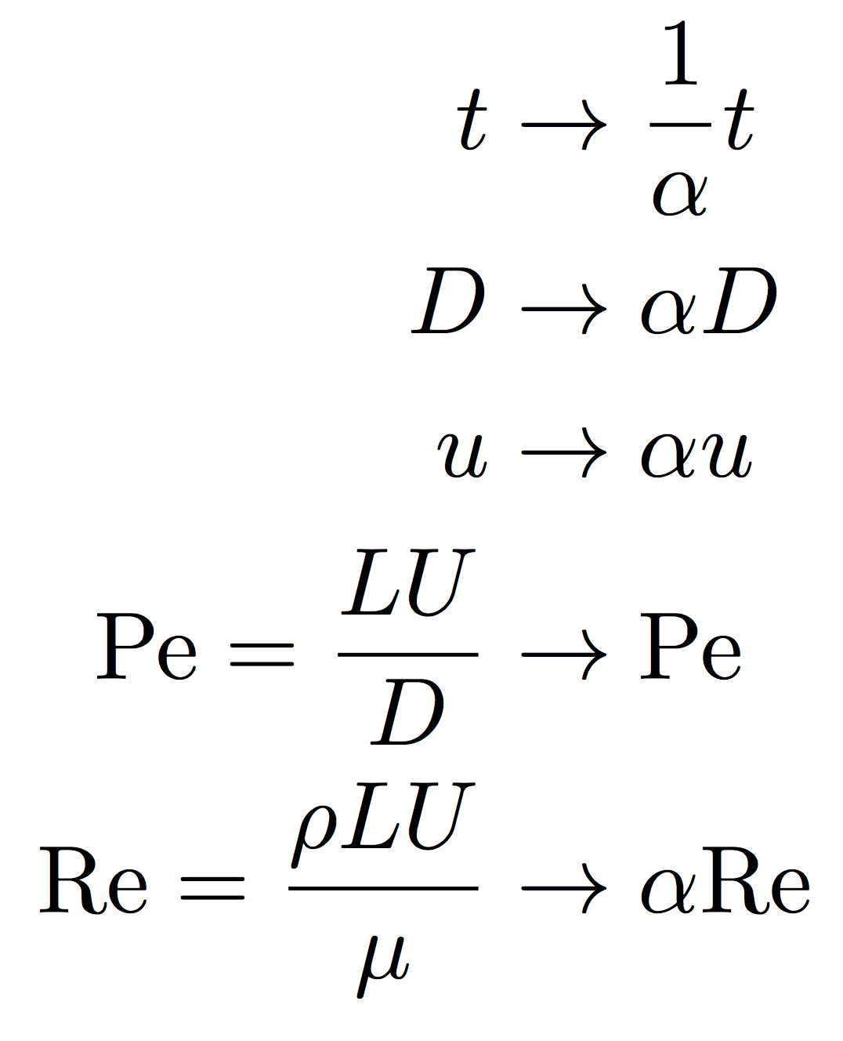
Constant Peclet number

Slide 8
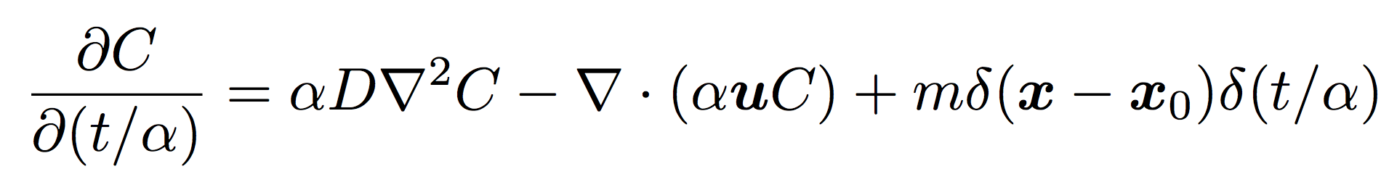
Constant Peclet number

Slide 9
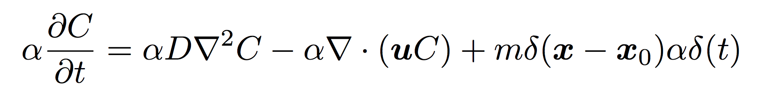
Constant Peclet number
All function are linear in time, a constant scaling does not effect the equation

Slide 10
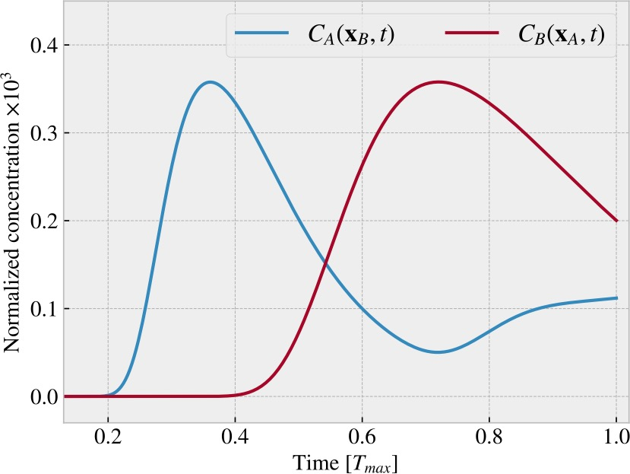
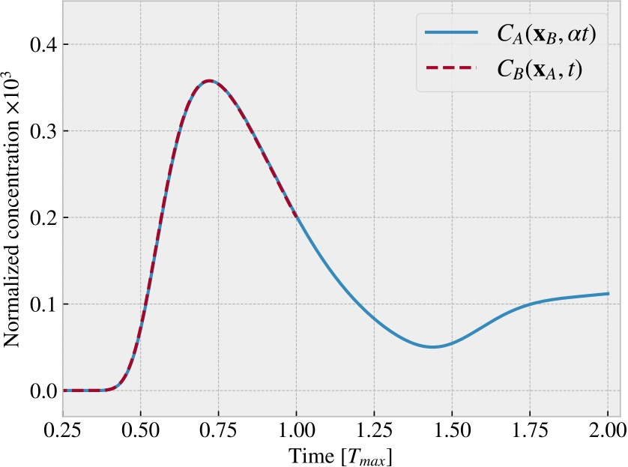
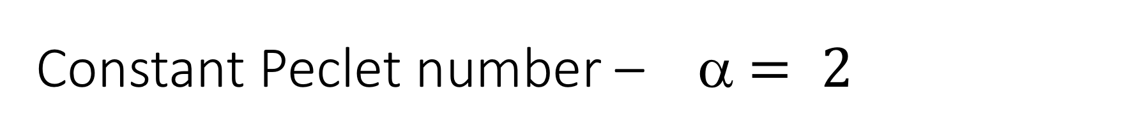
Constant Peclet number – α $= 2$

Slide 11
Maximizing concentration

Slide 12
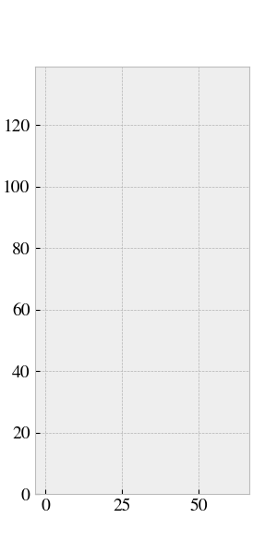
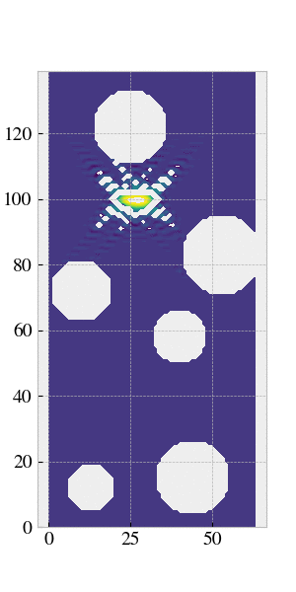
Maximizing concentration

Slide 13
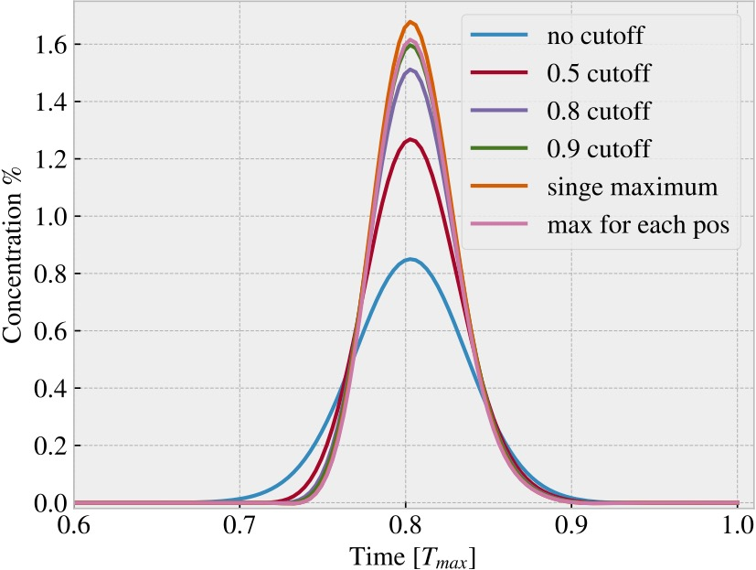
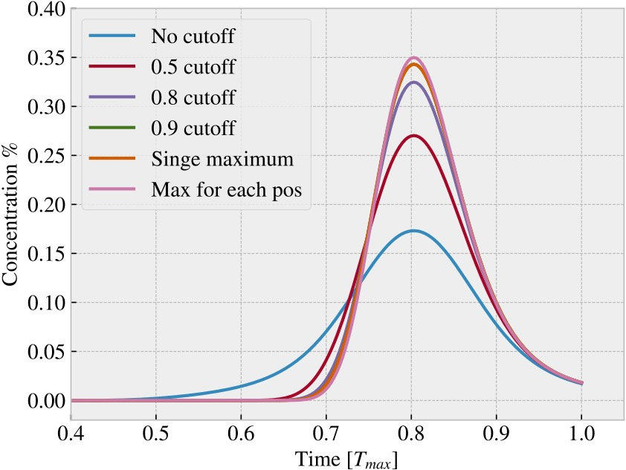
Maximizing concentration
Pe = 150,
Different injection methods optimalize the consentration profile for different Peclet numbers
Pe = 30

